Slide 1
Forecasting Currency Exchange Trend
My Case Study is United States Dollar (USD) vs Canadian Dollar (CAD)
Master’s Thesis
By: Akubue Simon C
On: 18-Dec-2024

Slide 2
Motivation
Majority of the Forex traders lose their money due to inadequate knowledge on the dynamics of the market forces. Most of the times, market forces is determined by the Macroeconomics news from the countries around the world.
Mitigating against this high rate of losses formed the basis of my research dream on “Forecasting Forex Exchange Trend”

Slide 3
Content
Pre-Amble
Data Sources
Statistical
Technical
Macroeconomics
Algorithms
Flow Diagram
Models Comparison
Visualization
Result
Recommended Model
Future Plans

Slide 4
Pre-Amble
The foreign exchange (forex) market stands as one of the most dynamic and influential financial markets globally, facilitating the exchange of currencies and shaping international trade and investment. Among the myriad currency pairs traded in this market, the USD/CAD pair occupies a significant position due to its prominence in North American trade and its influence on the economies of the United States and Canada.

Slide 5
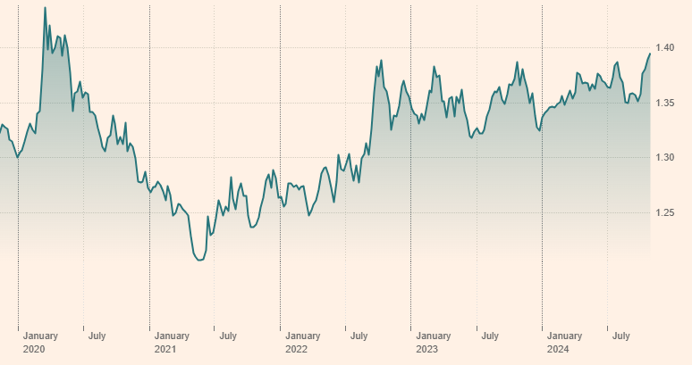
Last five years data on USD/CAD
https://markets.ft.com/data/currencies/tearsheet/summary?s=USDCAD

Slide 6
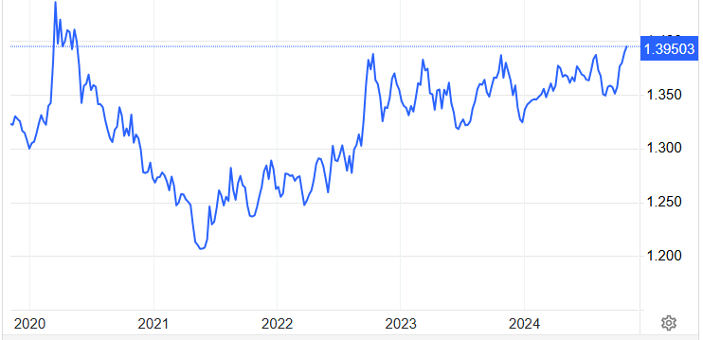
Last fifty years data on USD/CAD
https://tradingeconomics.com/canada/currency

Slide 7
Data Sources
FRED
Federal Reserve Economic Data
Macroeconomics data
Split
Scale
Train/Test
Evaluate
Forecast
Forex Market
DataFrame
Statistical data
Technical data

Slide 8
Data Source {Statistical}
My Data Set is taken from either of these two sources:
Tick Data Suite (TDS) ➔ From year 2003 to May-2024 {with over 5,500 records}
(b) Investing.Com ➔ From 1982 to May-2024 {with over 11,100 records}
The data in either of these two cases is maintained on a daily bases.

Slide 9
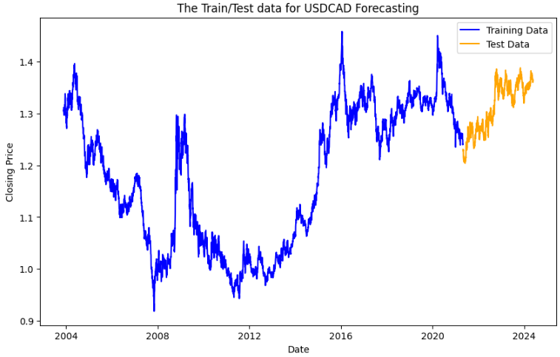
Raw data from TDS

Slide 10
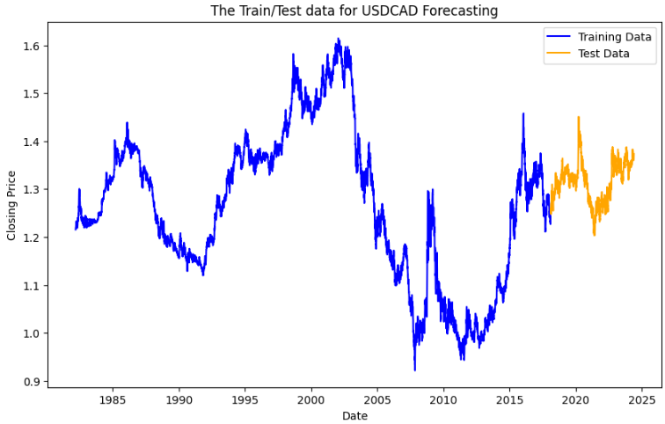
Raw data from Investing.Com

Slide 11
Data Source {Macroeconomics}
The following Macroeconomics data played a strong role in my model. They were sourced from the Federal Reserve Economic Data (FRED)’s(https://fred.stlouisfed.org/) database through an API that was exposed as XMLs.
Consumer Price Index (CPI) of USA Consumer Price Index (CPI) of Canada
The Interest Rates of USA The Interest Rates of Canada
Imports of USA Imports of Canada
Exports of USA Exports of Canada
Un-Employment Rates of USA Un-Employment Rates of Canada

Slide 12
Data Source {Technical}
The following technical indicators were integrated:
RSI – Relative Strength Index
This is a momentum indicator that measures the magnitude of recent price changes to analyze overbought or oversold conditions
(b) SMA - Simple Moving Average
This is the average price over the specified period. It is calculated by adding up the last "X" period's closing prices and then dividing that number by of Xs

Slide 13
Data Source {…..Technical}
(c) EMA – Exponential Moving Average
This is a type of moving average that gives more weight to recent data points compared to older data points. It is calculated by applying a smoothing factor to the previous EMA value and the current price.
(d) MACD - Moving Average Convergence Divergence
This is a popular technical analysis indicator used to identify trend reversals and momentum changes in financial markets, including stocks, currencies, and commodities. It consists of three components: the MACD line, the signal line, and the histogram.

Slide 14
Algorithms
I am comparing many models like:
I am considered the following models for my forecasting:
XGBoost model
Lasso Regression model
Ridge Regression model
Linear Regression model
AdaBoost Regression model
Random Forest Regressor model
Bayesian Ridge Regression model
Support Vector Regression (SVR) model

Slide 15
The Model’s Flow Diagram
Data Source 01
FRED
Split & Scale the Data
Macroeconomics data
Investing.Com
Train the Model
Selected Source (01 or 02)
DataFrame
Evaluate the Model
Data Source 02
Predict the Future
Technical data {RSI, SMA, EMA, MACD}
Tick Data Suite (TDS)
Display the Results graphically & tabular form

Slide 16
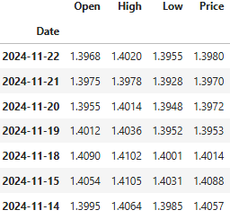
Statistical Data

Slide 17
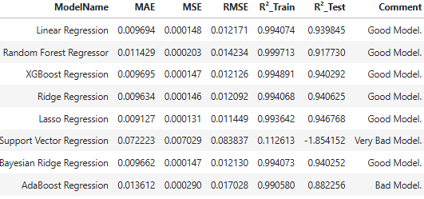
Models Comparison {Data from Investing.Com}
90% Train – 10% Test Splitting, with FRED’s Macroeconomics data

Slide 18
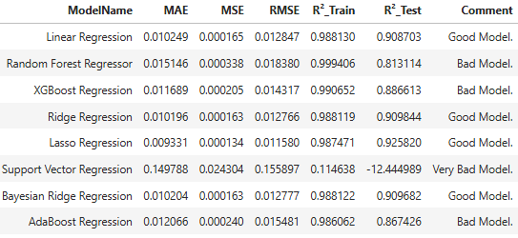
Models Comparison {Data from TDS}
85% Train – 15% Test Splitting, with FRED’s Macroeconomics data

Slide 19
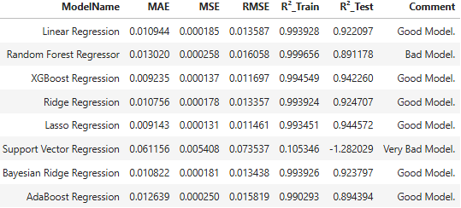
Models Comparison {Data from Investing.Com}
90% Train – 10% Test Splitting, with World Bank’s Macroeconomics data

Slide 20
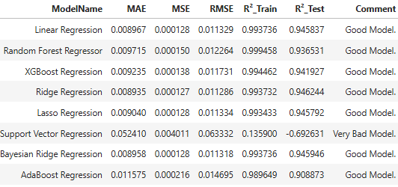
Models Comparison {Data from Investing.Com}
90% Train – 10% Test Splitting, without FRED’s Macroeconomics data

Slide 21
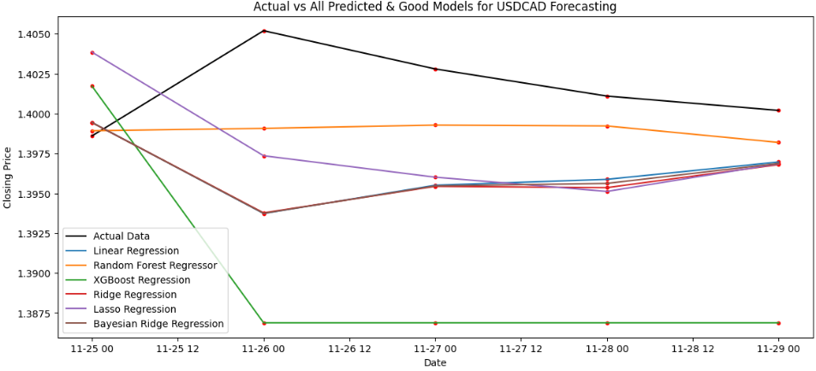
Visualization {Data from Investing.Com}
90% Train – 10% Test Splitting, with FRED’s Macroeconomics data

Slide 22
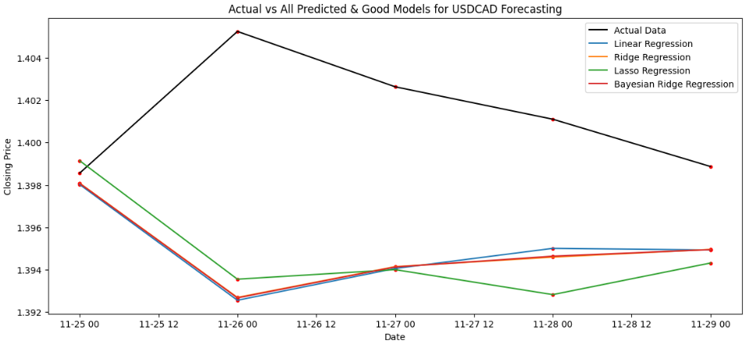
Visualization {Data from TDS}
85% Train – 15% Test Splitting, with FRED’s Macroeconomics data

Slide 23
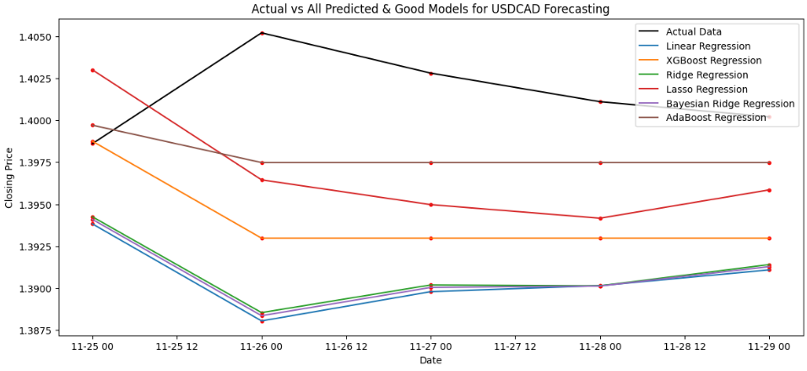
Visualization {Data from Investing.Com}
90% Train – 10% Test Splitting, with World Bank’s Macroeconomics data

Slide 24
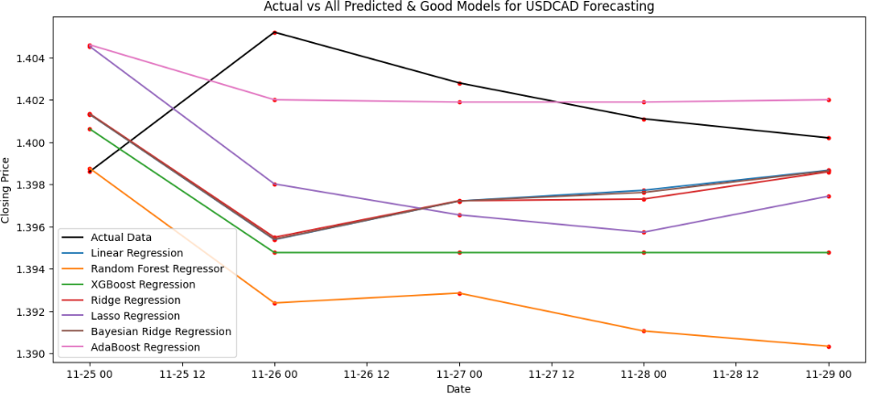
Visualization {Data from Investing.Com}
90% Train – 10% Test Splitting, without Macroeconomics data

Slide 25
Calibration approach
Dates
Index Values
01.11.2024
134.26
No of Business Days = 23
Diff = 0.019395
01.10.2024
124.0
Incremental Value = Diff/No of Business Days

Slide 26
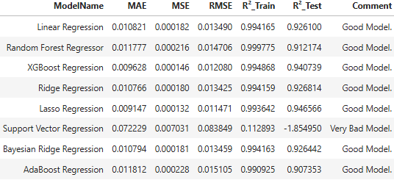
Visualization {Data from Investing.Com}
90% Train – 10% Test Splitting, with FRED’s Calibrated Macroeconomics data values

Slide 27
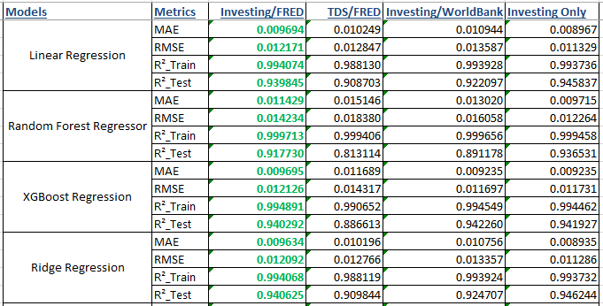
Visualization {Models with Data Comparism}
Comparing the data from different sources.

Slide 28
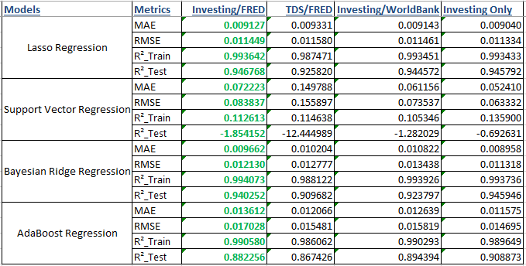
Visualization {Models with Data Comparism}
Comparing the data from different sources.

Slide 29
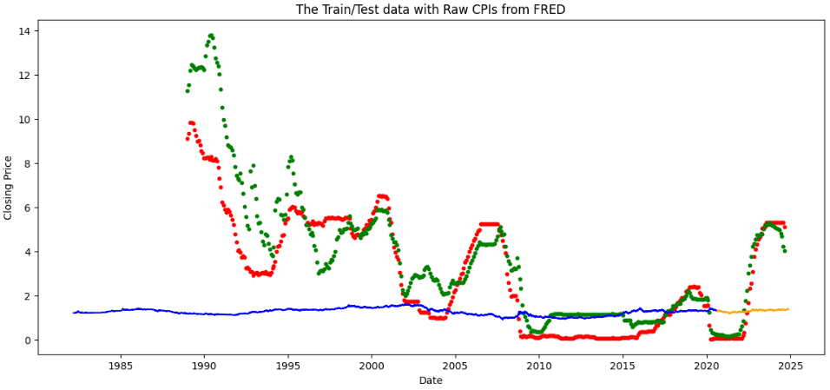
Visualization {Data from Investing.Com vs Data from FRED}

Slide 30
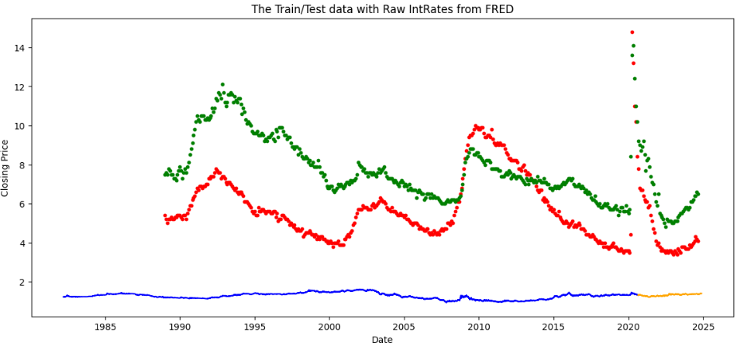
Visualization {Data from Investing.Com vs Data from FRED}

Slide 31
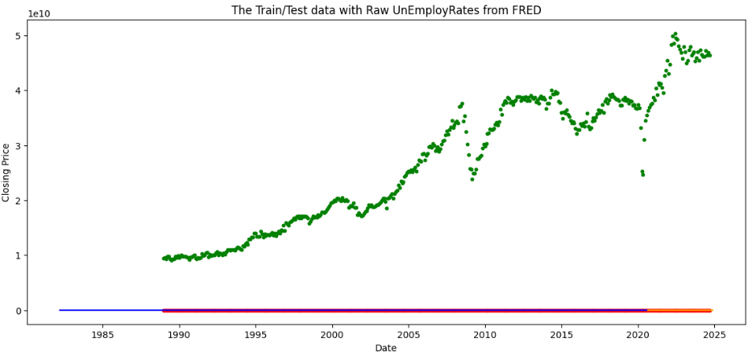
Visualization {Data from Investing.Com vs Data from FRED}

Slide 32
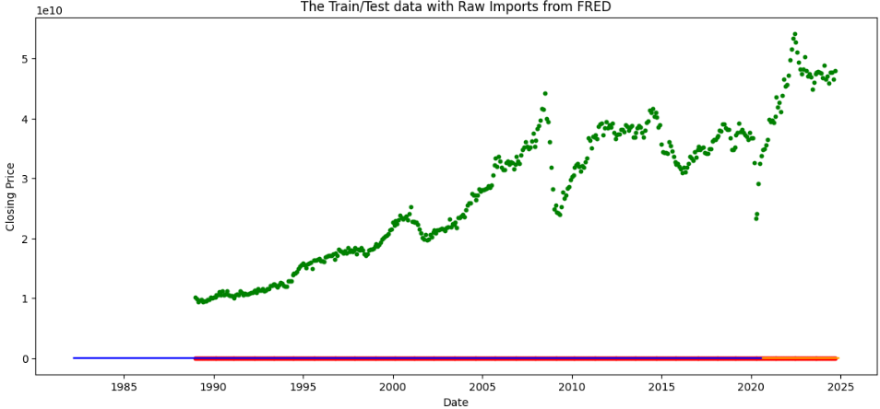
Visualization {Data from Investing.Com vs Data from FRED}

Slide 33
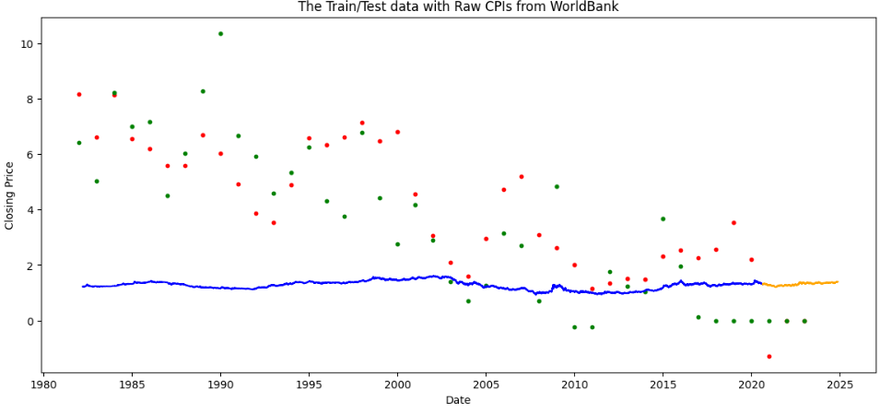
Visualization {Data from Investing.Com vs Data from WorldBank}

Slide 34
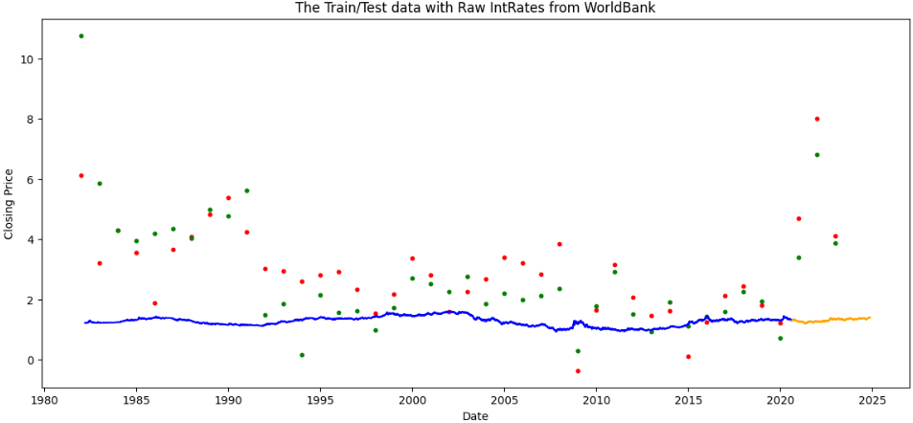
Visualization {Data from Investing.Com vs Data from WorldBank}

Slide 35
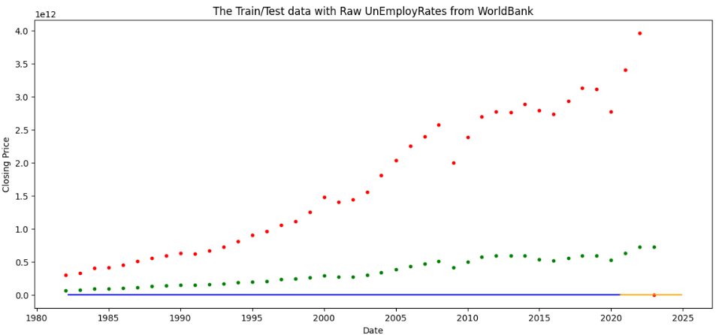
Visualization {Data from Investing.Com vs Data from WorldBank}

Slide 36
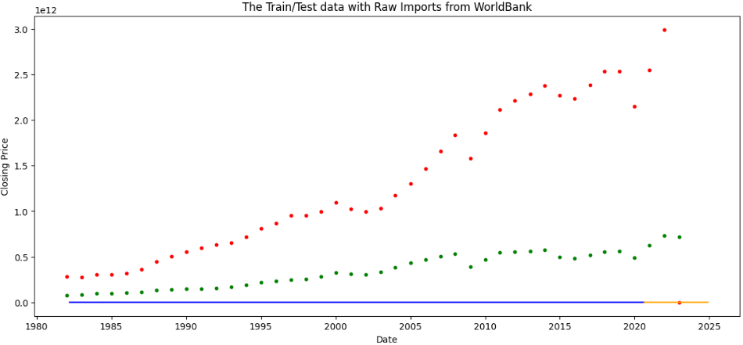
Visualization {Data from Investing.Com vs Data from WorldBank}

Slide 37
Result
From the above analysis, on reviewing the MAE and MSE, RMSE, and R² values from all the models considered, it is apparently clear that “Linear Regression”, “Random Forest Regressor (RFR)”, “Ridge Regression” and “Bayesian Ridge Regression” displayed wonderful results. However, I will be relying more on “Random Forest Regressor (RFR)” due to its robustness about being exposed to many hyperparameters for tuning.

Slide 38
Random Forest Regressor (RFR)
Random Forest Regressor (RFR) is a supervised learning algorithm belonging to the ensemble learning family, specifically the random forest method, used for regression tasks. It's an extension of the Random Forest algorithm for classification.
Random Forest Regressor is known for its robustness, scalability, and ability to handle high-dimensional data with a large number of features. It often performs well across a wide range of regression problems and is less prone to overfitting compared to individual decision trees.

Slide 39
Future Plans
I will also explore alternative source where I can access the Macroeconomics indices maintained at more frequent basis; possibly weekly, or even daily levels.
I plan to improve on my model by adding more Technical features.
I will explore a way of automatically accessing the Statistical data from a sources like Investing.Com or Tick Data Suite(TDS) whose data is as close as the live data.

Slide 40
Thank you

